Slide 1





Longitudinal Flow Matching for Trajectory Modeling
Mohammad Mohaiminul Islam — Thijs P. Kuipers — Sharvaree Vadgama — Coen de Vente
Afsana Khan — Clara I. Sánchez — Erik J. Bekkers

Slide 2
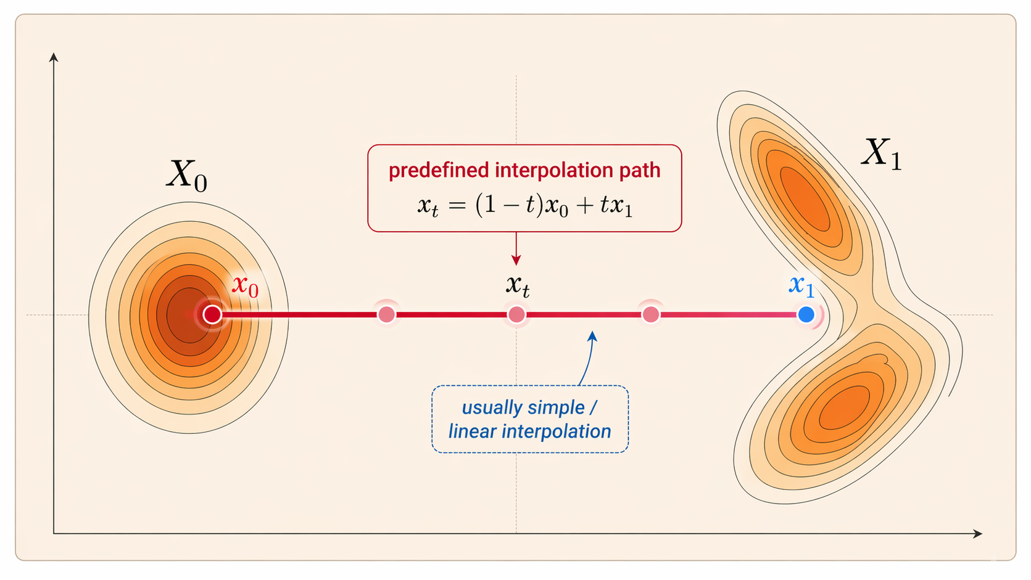
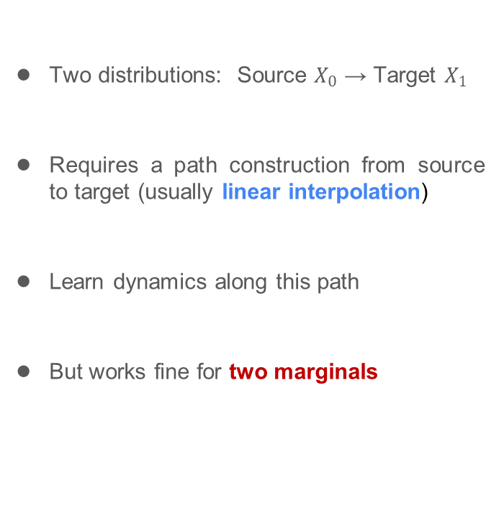
Standard Flow Matching
Two distributions: ​Source $X_{0}$ → Target $X_{1}$​
Requires a path construction from source to target (usually linear interpolation)
Learn dynamics along this path
But works fine for two marginals
Notes:
let's recall the standard flow matching setting for a bit, where we usually have two distributions, a source and a target, and construct a probability path connecting them.
And often it's just a linear interpolation, and the model learns to push the probability mass along that path.
However, this standard formulation is limited because it only accounts for these two marginals.

Slide 3
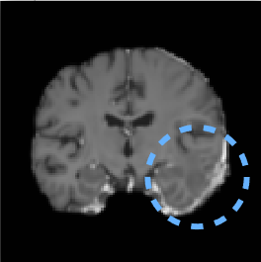
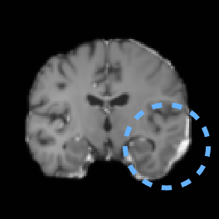
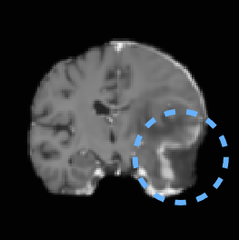
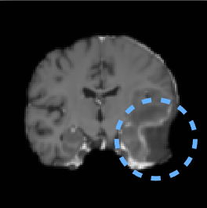




The Problem
Longitudinal data → sparse, irregular, high-dimensional
Notes:
But now what if we have something like this? Multiple observations along the path! How do we construct the path and learn with flow matching?

Slide 4
The Problem
Longitudinal data → sparse, irregular, high-dimensional
Pairwise transitions → no global consistency and temporal alignment
Notes:
Well! A straightforward thing people tried out is to model pairwise transitions between consecutive observations.
As you can intuitively understand that this only gives local transitions; it does not guarantee a globally consistent
it also struggles with temporal alignment.

Slide 5
The Problem
Longitudinal data → sparse, irregular, high-dimensional
Pairwise transitions → no global consistency and temporal alignment
Piecewise linear Interp. → Sharp transitions, bad behavior near intermediate marginals
Notes:
Another simple option is piecewise linear interpolation between observed timepoints.
This works somewhat better than pairwise,
but it creates sharp transitions at the intermediate marginals, because the direction changes abruptly from one segment to the next.
As a result, the trajectory is not smooth and can behave poorly around those intermediate observations

Slide 6
The Problem
Longitudinal data → sparse, irregular, high-dimensional
Pairwise transitions → no global consistency and temporal alignment
Piecewise linear Interp. → Sharp transitions, bad behavior near intermediate marginals
High-dimensional spline fitting → expensive, noisy and unstable (e.g., Runge phenomenon)
Notes:
Another idea is to fit splines through the observations. But in high-dimensional settings, spline fitting can become noisy and unstable, especially with irregular sparse observation.
So, then the question becomes: what is a better way of constructing probability path through multiple observed marginals?

Slide 7
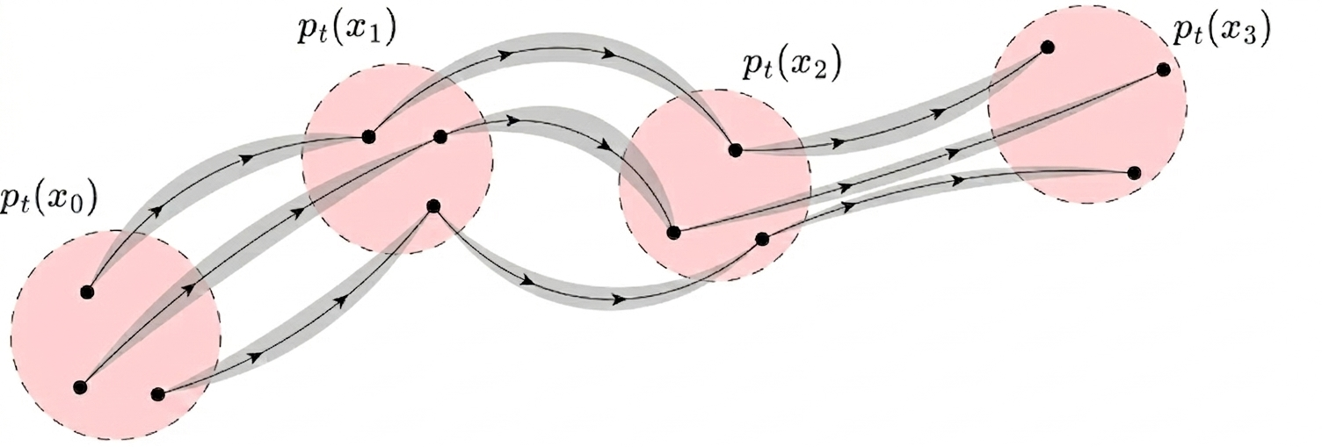

Interpolative Multi-Marginal Flow Matching (IMMFM)
Quadratic Interp. with look-ahead
$$μ_{t}\left(z\right)=x_{t_{i}}+v_{i}\left(t−t_{i}\right)+\frac{1}{2} α_{t}(v_{i}−v_{i+1})(t−t_{i})$$
Resolves unstable, expensive spline fitting via quadratic interpolation with look-ahead.
Notes:
Our method, addresses this problem via a quadratic interpolation with look ahead scheme.
Conceptually this sits between a piecewise linear interpolation, and a spline-based constructions.

Slide 8
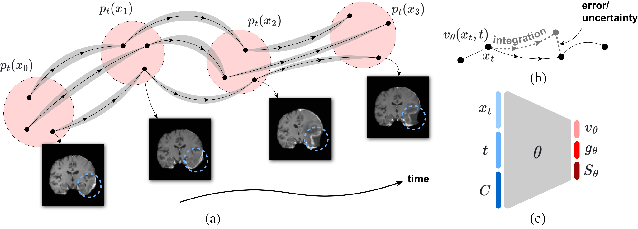
Interpolative Multi-Marginal Flow Matching (IMMFM)
Quadratic Interp. with look-ahead
$$μ_{t}\left(z\right)=x_{t_{i}}+v_{i}\left(t−t_{i}\right)+\frac{1}{2} α_{t}(v_{i}−v_{i+1})(t−t_{i})$$
Resolves unstable, expensive spline fitting via quadratic interpolation with look-ahead.
Absorbs complex volatility ignored by the smooth drift → learned diffusion coefficient
Notes:
Now this path and the drift learnt on it represents the mean evolution of the trajectories.
But in practice, the actual dynamics can still deviate from this mean path. So we learn a diffusion coefficient to capture the remaining variability around it.

Slide 9
Interpolative Multi-Marginal Flow Matching (IMMFM)
Quadratic Interp. with look-ahead
$$μ_{t}\left(z\right)=x_{t_{i}}+v_{i}\left(t−t_{i}\right)+\frac{1}{2} α_{t}(v_{i}−v_{i+1})(t−t_{i})$$
Resolves unstable, expensive spline fitting via quadratic interpolation with look-ahead.
Absorbs complex volatility ignored by the smooth drift → learned diffusion coefficient
Learns globally consistent, continuous stochastic dynamics sparse data.
Notes:
With this construction, we show that can learn globally consistent, stochastic dynamics from sparse and noisy data.

Slide 10
Interpolative Multi-Marginal Flow Matching (IMMFM)
Quadratic Interp. with look-ahead
$$μ_{t}\left(z\right)=x_{t_{i}}+v_{i}\left(t−t_{i}\right)+\frac{1}{2} α_{t}(v_{i}−v_{i+1})(t−t_{i})$$
Resolves unstable, expensive spline fitting via quadratic interpolation with look-ahead.
Absorbs complex volatility ignored by the smooth drift → learned diffusion coefficient
Learns globally consistent, stochastic dynamics from noisy sparse data.
Practical conditioning → no explicit class conditioning required!
Notes:
One practical advantage is, in this setting no explicit class conditioning needed for modeling different trajectories, for example diseased and a healthy one.
The observed marginals themselves already provide the conditioning signal.

Slide 11



Training Objective
Optimize three decoupled components: 1) Flow drift , 2) Score , 3) Diffusion .
Notes:
With all those details in place, we have these three components in the training objective: the flow drift, the score, and the diffusion.
This gives us a three different flavors of models, from simpler deterministic dynamics to stochastic ones.
Each of these variants can be more suitable depending on the application and the level of uncertainty in the data.
But it is also useful computationally, since this decomposition lets us train in a simulation-free way

Slide 12
Training Objective
Optimize three decoupled components: 1) Flow drift , 2) Score , 3) Diffusion .
→ O-IMMFM: Deterministic ODE

Slide 13

Training Objective
Optimize three decoupled components: 1) Flow drift , 2) Score , 3) Diffusion .
→ O-IMMFM: Deterministic ODE
→ S-IMMFM: Stochastic SDE
Notes:
Here is the score matching terms, together with the drift this allows us to train the model in a simulation free way

Slide 14

Training Objective
Optimize three decoupled components: 1) Flow drift , 2) Score , 3) Diffusion .
→ O-IMMFM: Deterministic ODE
→ S-IMMFM: Stochastic SDE
→ SU-IMMFM: SDE + diffusion
Notes:
Finally, we have the diffusion term.

Slide 15
Training Objective
Optimize three decoupled components: 1) Flow drift , 2) Score , 3) Diffusion .
→ O-IMMFM: Deterministic ODE
→ S-IMMFM: Stochastic SDE
→ SU-IMMFM: SDE + diffusion
We prove: learning the residual term jointly does not bias the drift and score
Notes:
So here is the learned diffusion term we talked about in earlier slide
And we show that adding this term into the objective is fine and doesn’t mess up the optimization of drift/score.

Slide 16
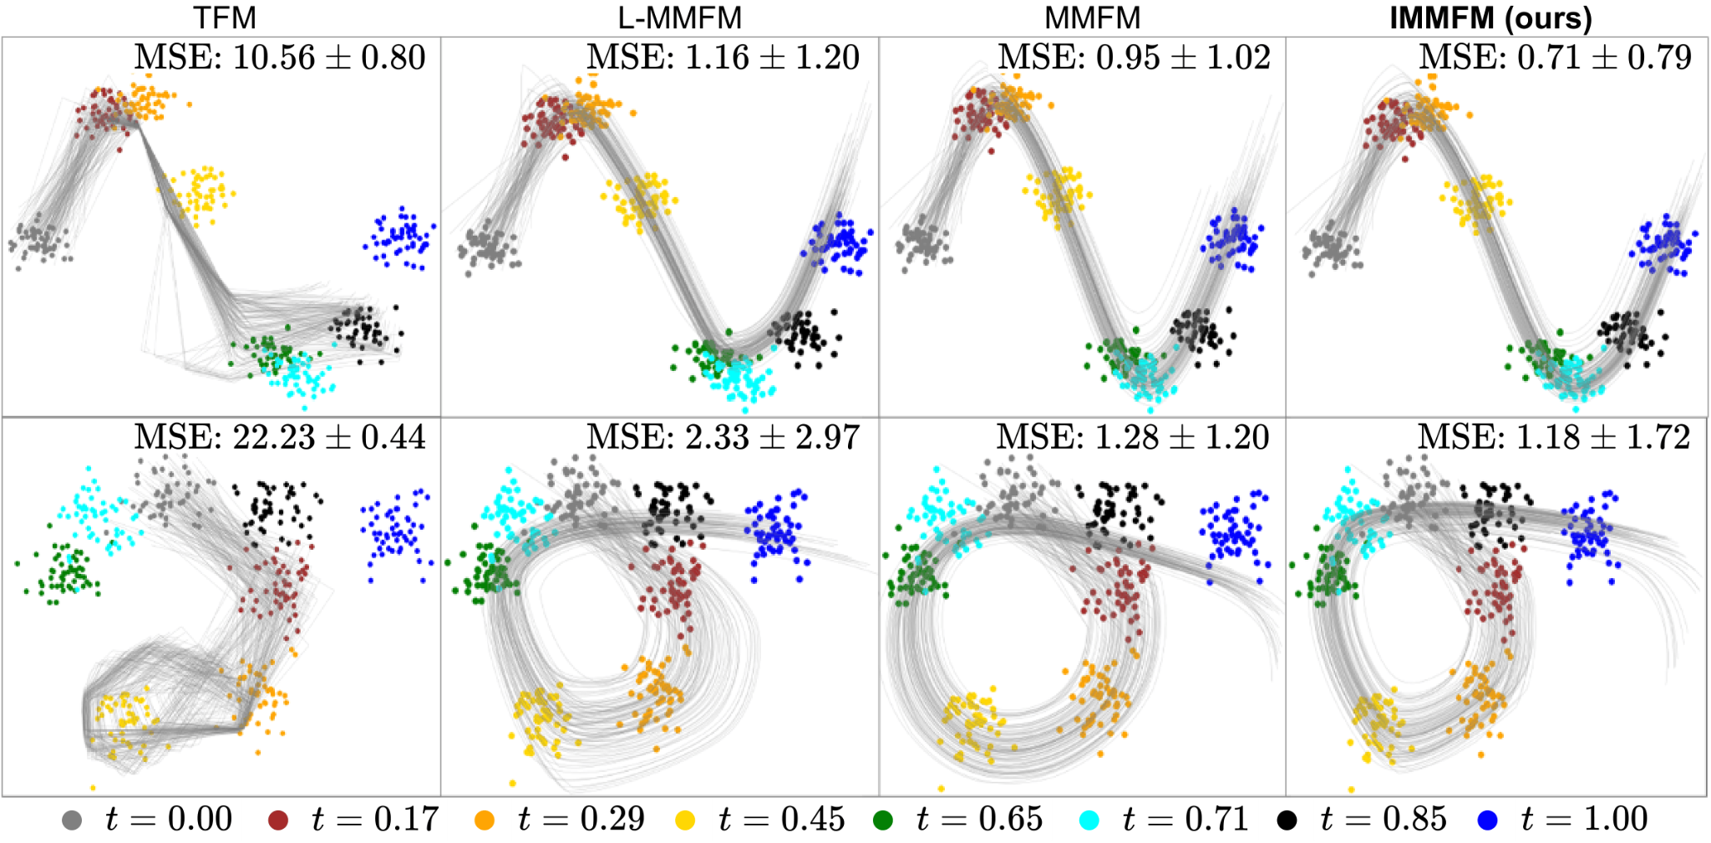
Results on Synthetic Data
8 time-points , each of the marginals is given by a Gaussian.
TMF → Rolling window based, L-MMFM →P. Linear interp. MMFM → Spline
Notes:
We first evaluate the method on synthetic data with eight timepoints, where each marginal is Gaussian.
We compare with most relevant method. And as you can see our method yields a better results.

Slide 17
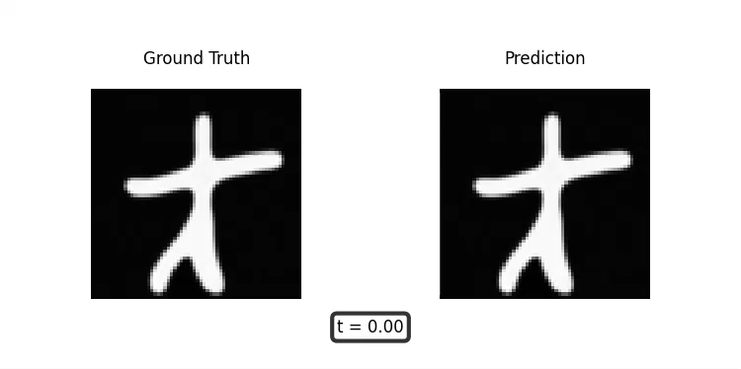
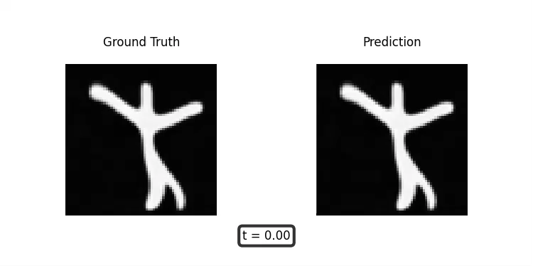
Motion Simulation
Ground Truth
Prediction
Ground Truth
Prediction
Notes:
So here we can see the motion of hands.

Slide 18
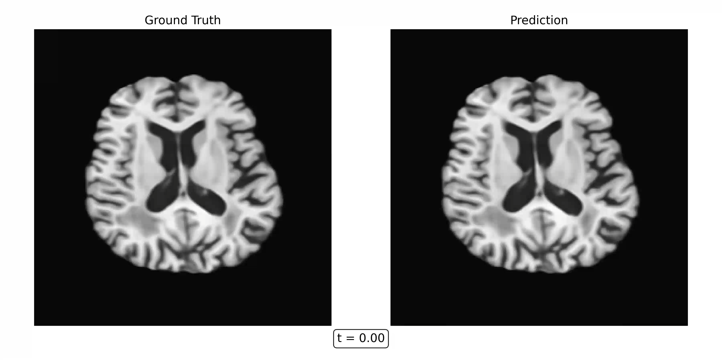
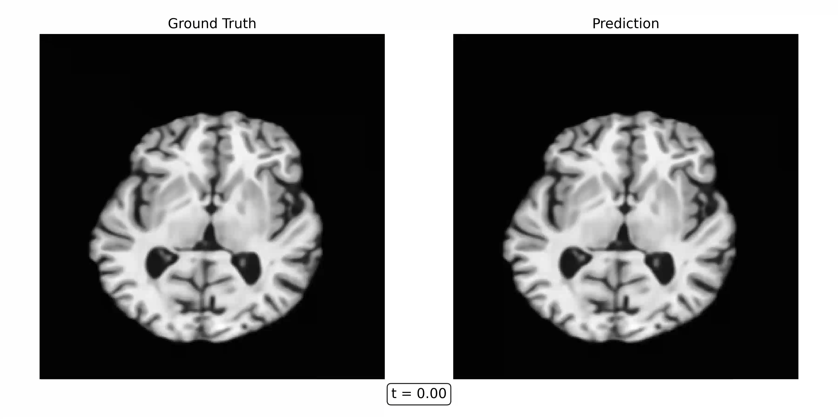
Brain Simulation
Ground Truth
Prediction
Ground Truth
Prediction
Notes:
So were can see a brain of Alzheimer’s patient.
The changes are bit subtle here around the black region here which is the ventricle.

Slide 19
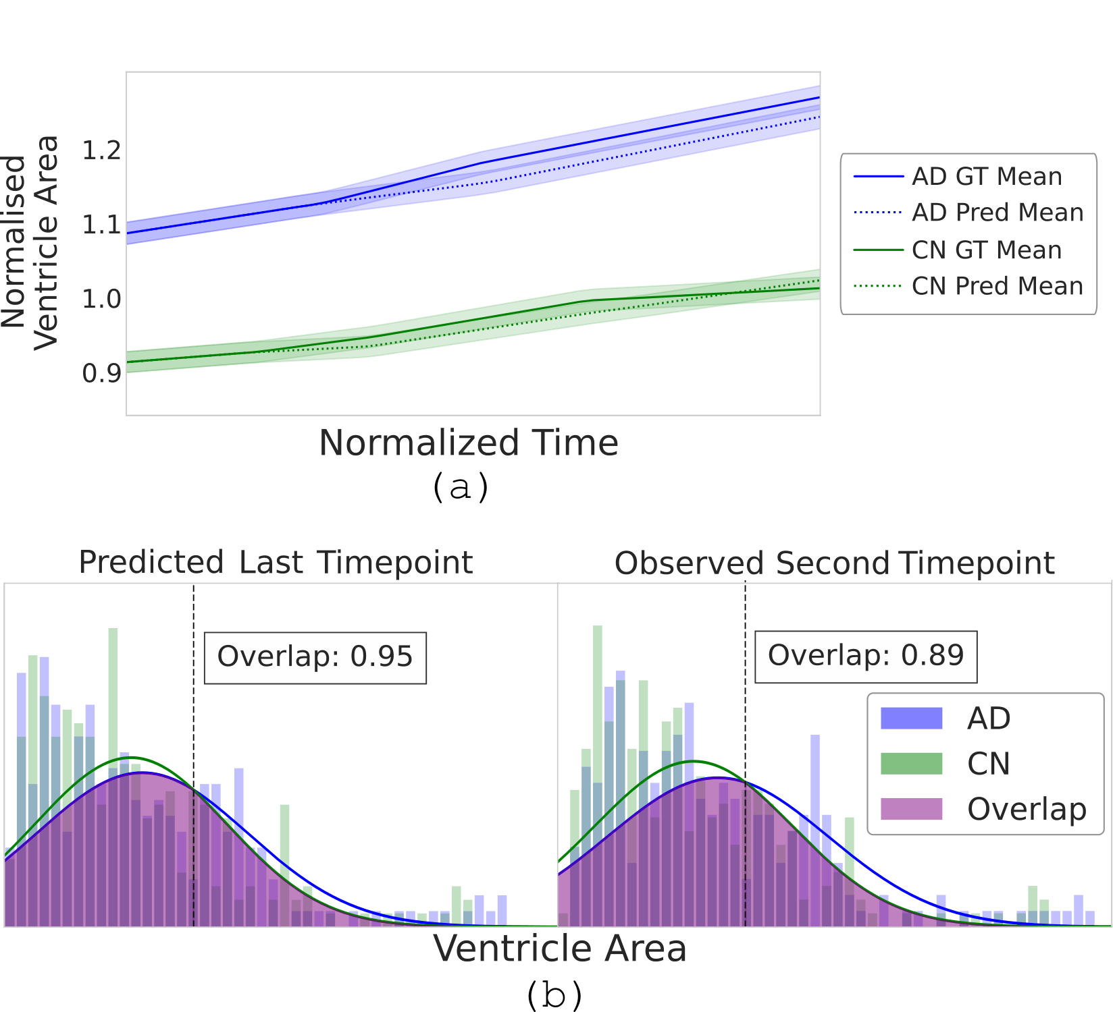
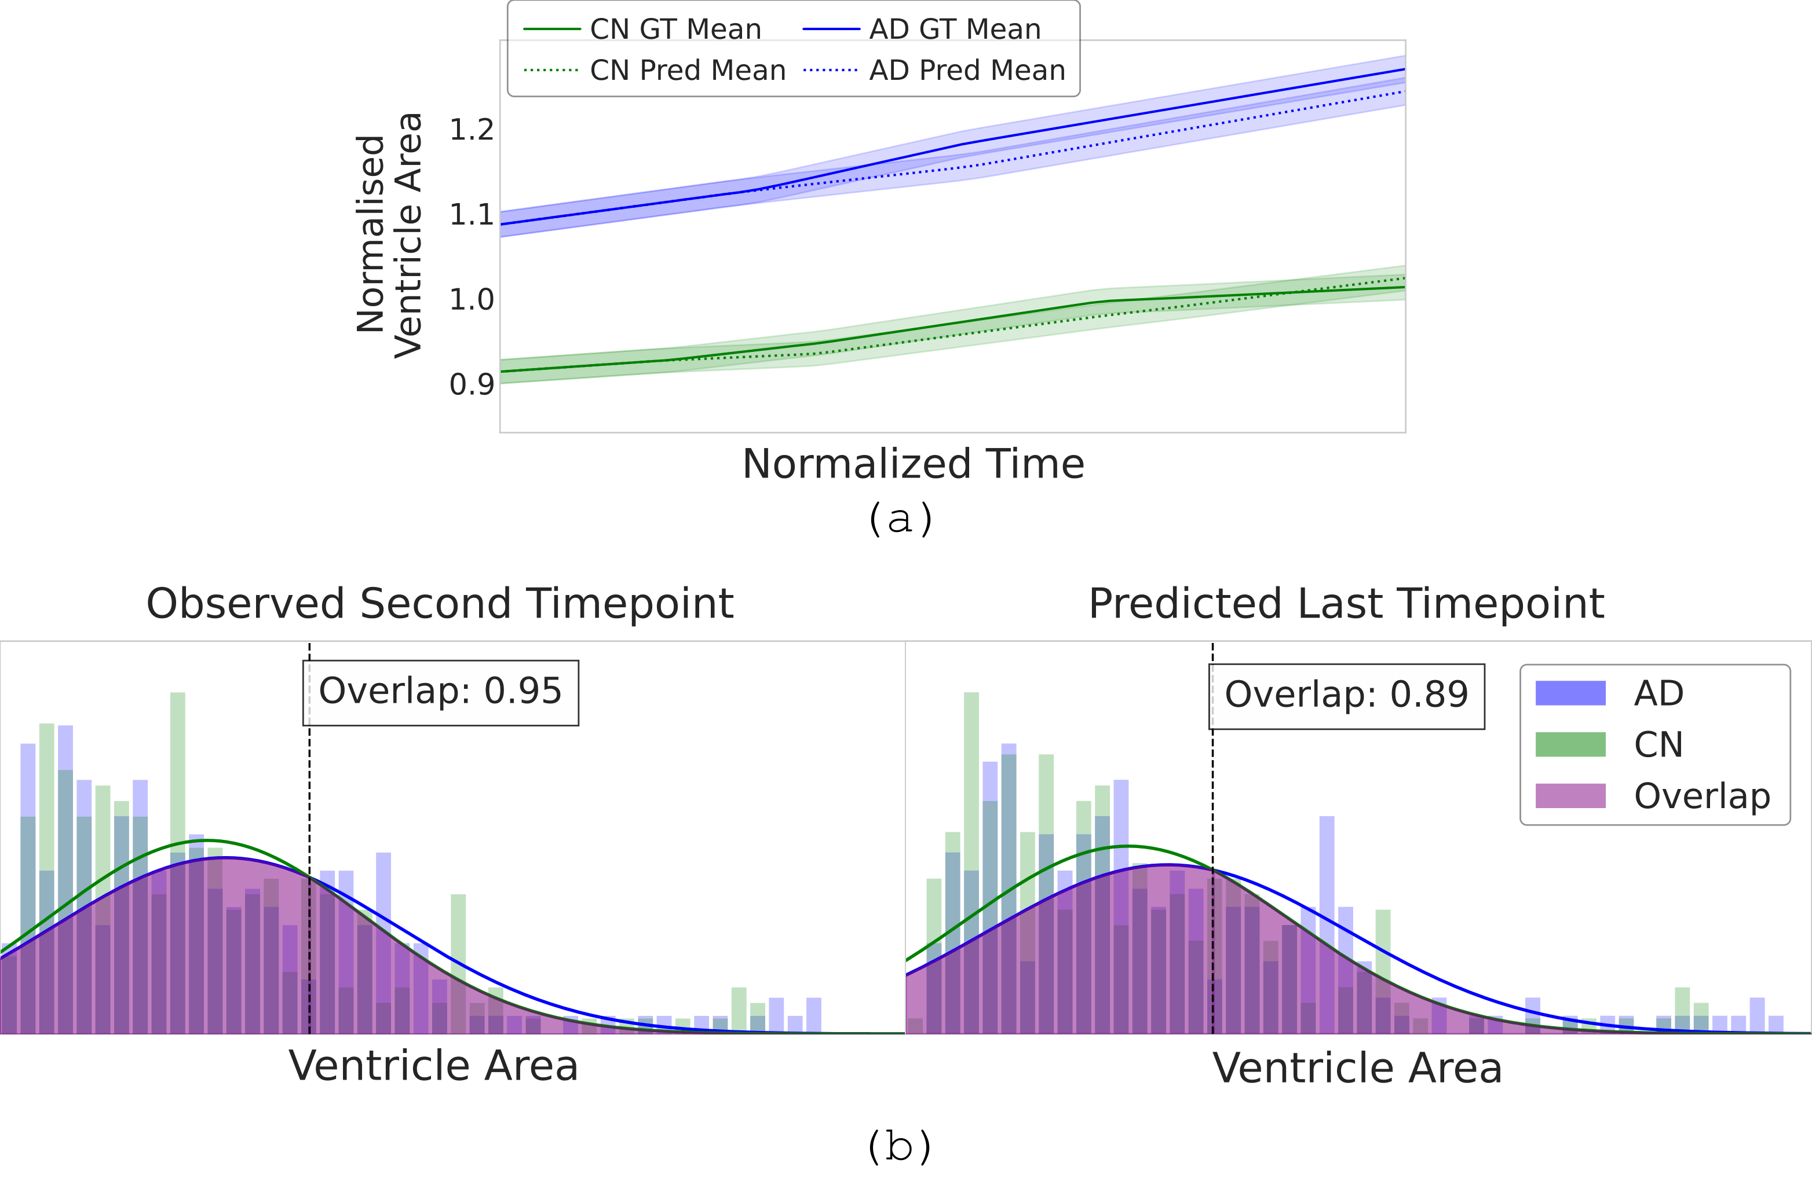
Alzheimer's patients Identification
Classification based on just ventricle area.
+9.1% on early Alzherimer (with 18-months lead time) Classification.
Notes:
We also evaluate the method on a downstream task of early Alzheimer’s identification through forecasting.
We start from the observations available up to 18 months and classify,
and then use the model to roll the trajectory forward to 36 months and then run the classifier on that predicted future state. This leads to a 9.1% improvement in classification.
That means we can possibly identify 9 more people 1.5years early.

Slide 20
Take away
Pairwise, Rolling window and Spline based paths struggle with Longitudinal data.
IMMFM’s quadratic look-ahead path construction improves over these approaches.
Learned diffusion captures residual volatility beyond the smooth drift, further improving performance
IMMFM Improves performance on synthetic and real-world data.
Notes:
Pairwise, Rolling window and Spline based methods has limitation when it comes to Longitudinal data.
Our path construction scheme improves over these.
We also learn residual variability around the mean path leading to further improvement.
We show strong results on real-word use case

Slide 21
Thank You !!
Notes:
The score tells the model how to correct stochastic perturbations, so samples stay in plausible, high-density regions of the data space.
The diffusion controls the strength of the stochastic perturbation around the main path, while the score tells the model how to correct that perturbation

